Slide 1
VISUAL THINKING STRATEGIES
we believe thoughtfully facilitated discussions of
art make education more engaging, inclusive, and equitable.

Slide 2
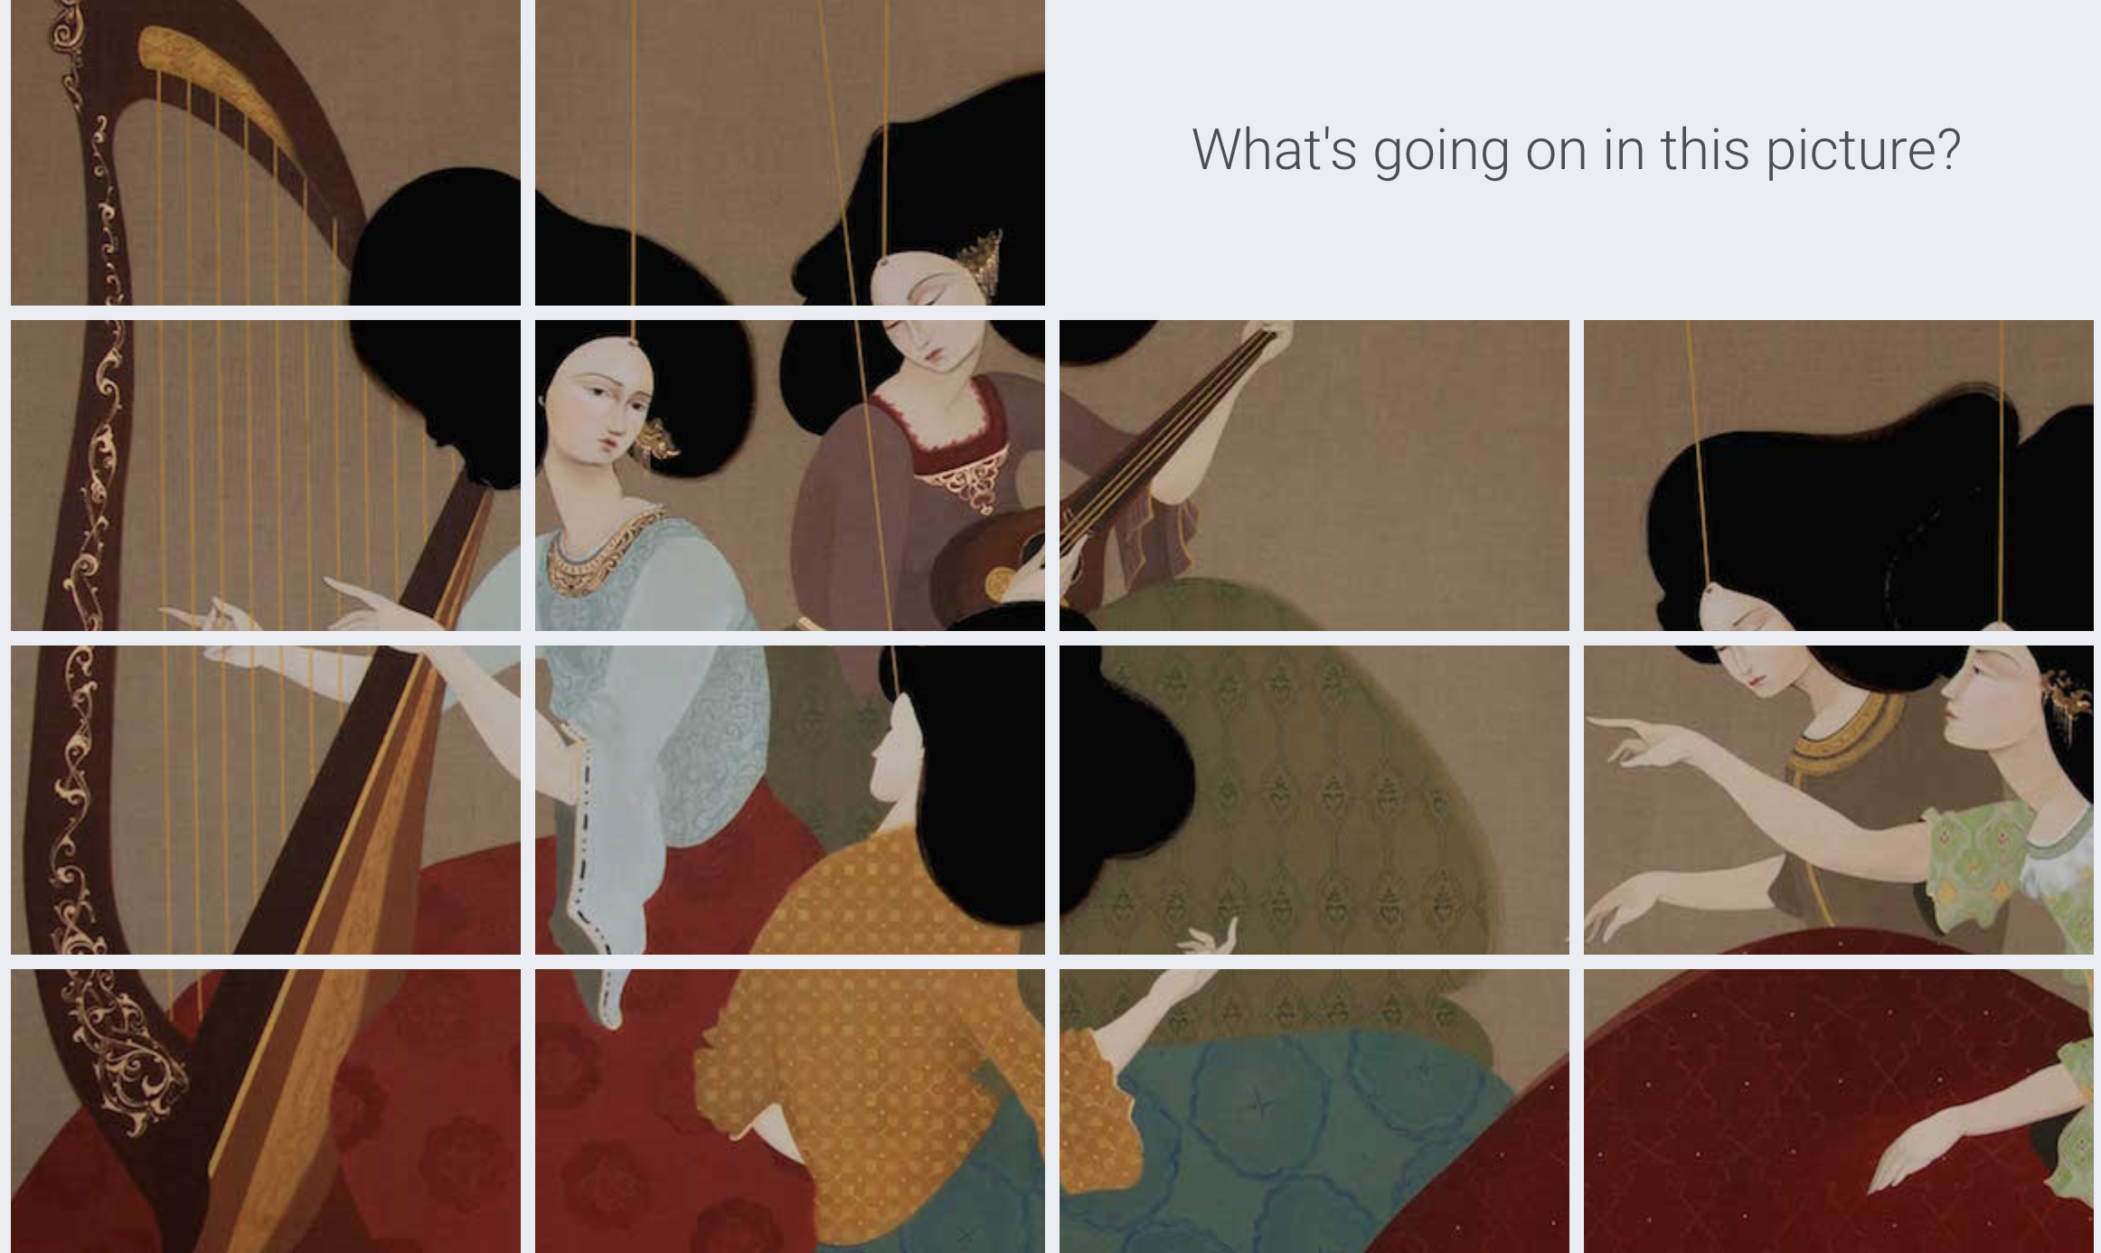

Slide 3
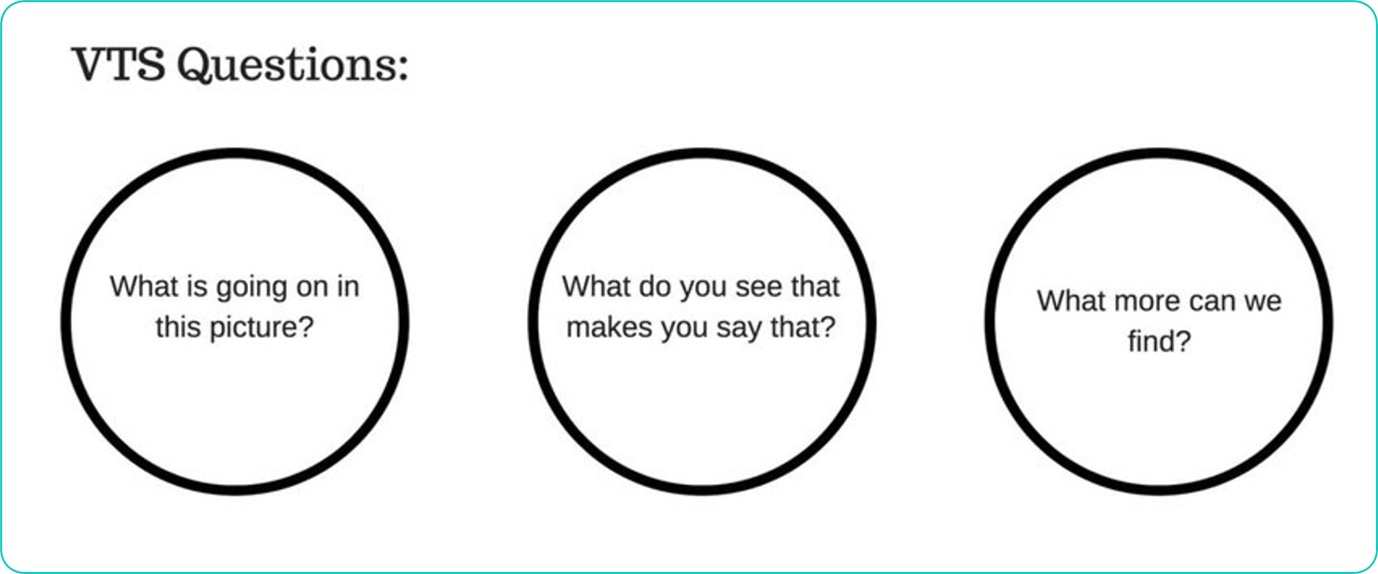

Slide 4

TAKE YOUr TIME

